Slide 1

Amazon Sales Data Analysis Project 📊✨📈
-Insights into Sales Trends, Product Performance, and Customer Behavior
Presented By:
Likitha Uddandapu
Date: 21-12-2024

Slide 2

AGENDA
Project Overview
Data Preparation
Key Business Questions and Insights
Recommendations

Slide 3
Project Overview
Objective: 🎯📋💡
Gain insights into sales data to understand factors influencing branch performance and customer preferences.
Dataset: 🗂️📊🌍
Sales transactions from 3 Amazon branches: Mandalay, Yangon, and Naypyitaw.
17 columns, 1000 rows, including details like product line, payment method, and ratings.
Key Areas of Analysis: 🔍📈📊
Product performance
Sales trends
Customer behavior

Slide 4
Data Preparation
Steps Taken: 🛠️⚙️📋
✅ Built the database and created the table structure.
✅ Ensured no NULL values by setting NOT NULL constraints.
✅ Performed feature engineering:
Added timeofday (Morning, Afternoon, Evening).
Extracted dayname (days of the week).
Extracted monthname (months of the year).
4.✅Solved Business Questions
Tools Used: SQL for queries, Power BI for visualizations. 💻📊🔧

Slide 5
General Dataset Insights
What is the count of distinct cities in the dataset?
For each branch, what is the corresponding city?
What is the count of distinct product lines in the dataset?
What is the count of distinct customer types in the dataset?
What is the count of distinct payment methods in the dataset?
Product Line Analysis
Which product line has the highest sales?
Which product line generated the highest revenue?
Which product line incurred the highest Value Added Tax?
For each product line, add a column indicating "Good" if its sales are above average, otherwise "Bad."
Calculate the average rating for each product line.
Which product line is most frequently associated with each gender?

Slide 6
Sales Trends and Revenue Analysis
How much revenue is generated each month?
In which month did the cost of goods sold reach its peak?
Identify the branch that exceeded the average number of products sold.
Customer and Payment Analysis
Which customer type occurs most frequently?
Identify the customer type contributing the highest revenue.
Identify the customer type with the highest VAT payments.
Identify the customer type with the highest purchase frequency.
Determine the predominant gender among customers.
Examine the distribution of genders within each branch.
Which payment method occurs most frequently?

Slide 7
Time-Based Analysis
Count the sales occurrences for each time of day on every weekday.
Identify the time of day when customers provide the most ratings.
Determine the time of day with the highest customer ratings for each branch.
Identify the day of the week with the highest average ratings.
Determine the day of the week with the highest average ratings for each branch.
City-Based Analysis
In which city was the highest revenue recorded?
Determine the city with the highest VAT percentage.
Links Here
All SQL queries here in .SQL

Slide 8


Microsoft Power BI

Slide 9
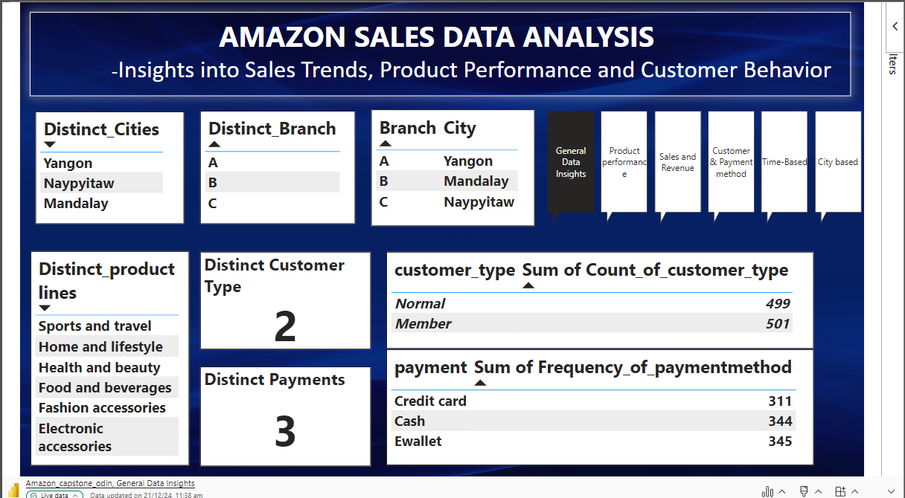

Slide 10
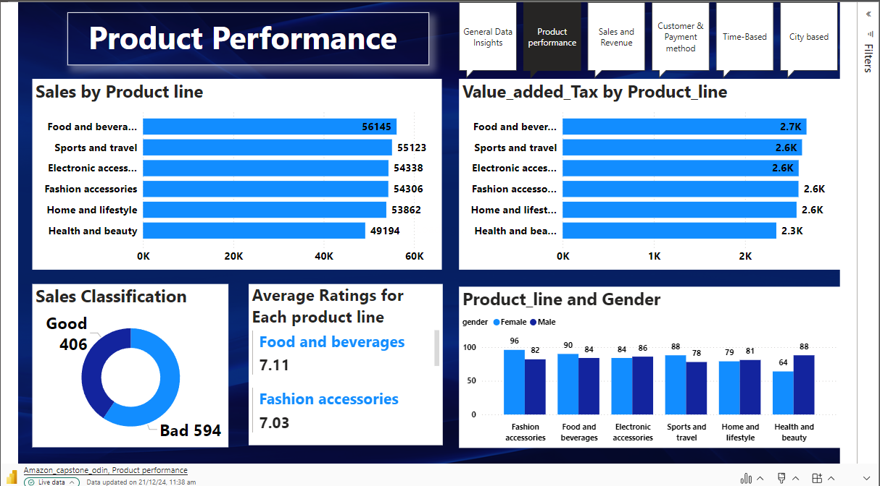
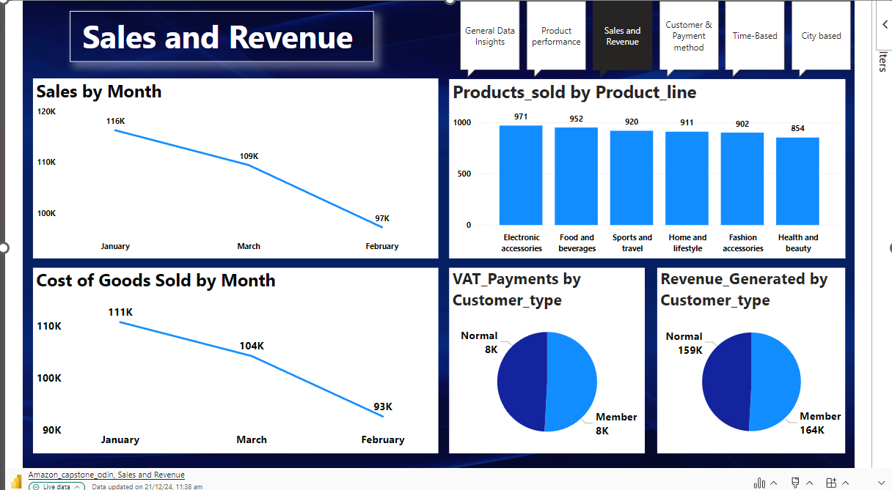

Slide 11
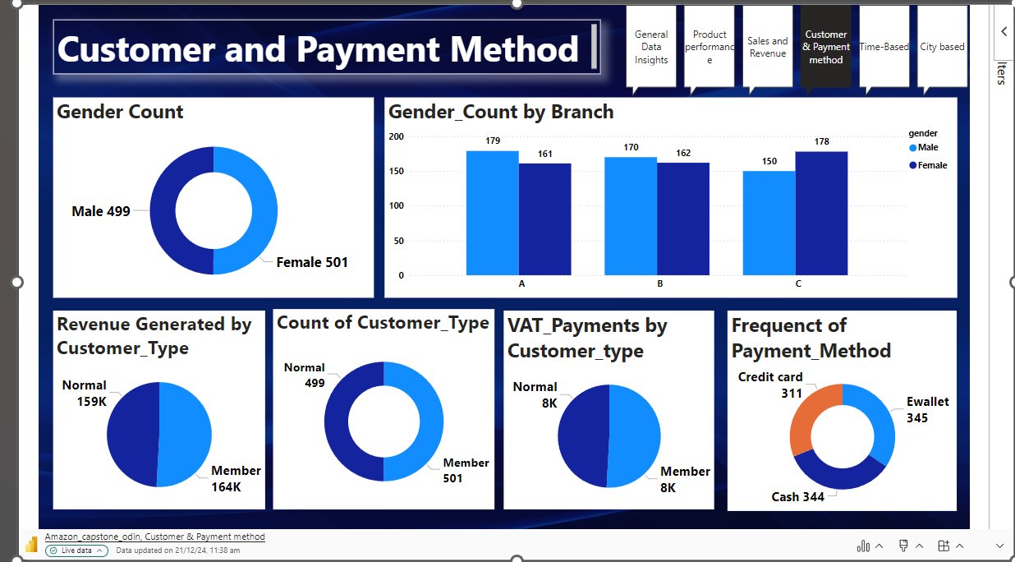

Slide 12
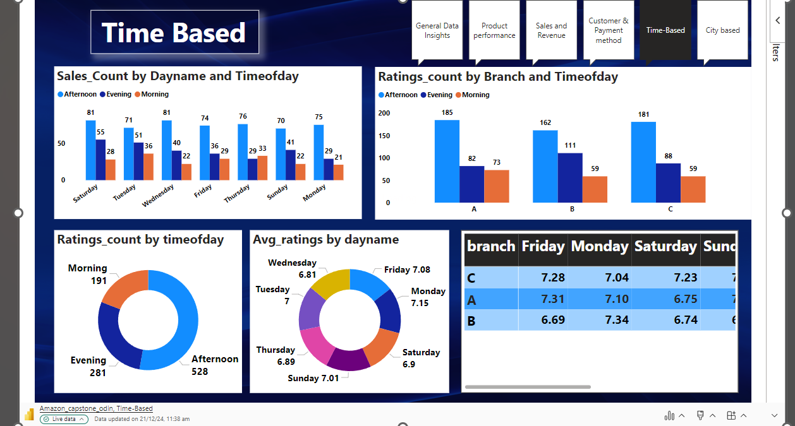

Slide 13
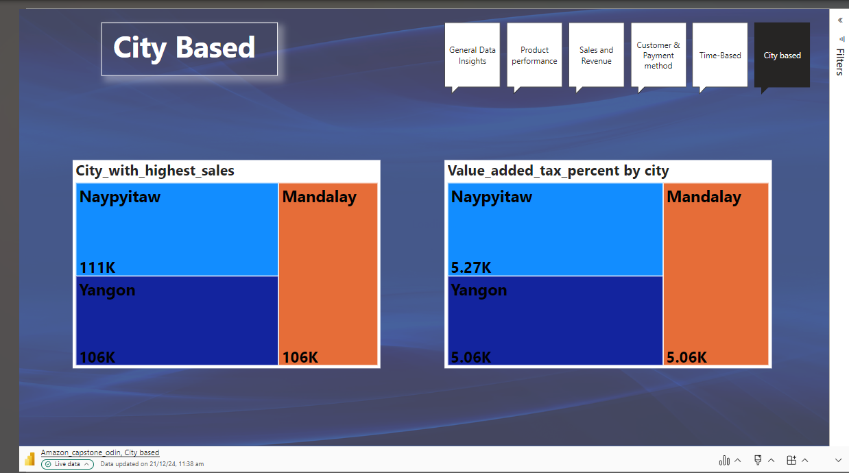

Slide 14
Recommendations
General Dataset Insights
Use the count of distinct cities, product lines, customer types, and payment methods to understand dataset diversity and the scope of operations.
Ensure that each branch is analyzed separately to identify location-specific patterns.
If certain product lines or customer types are underrepresented, consider strategies to target them, like marketing campaigns or introducing new products.
Product Line Analysis
Focus on product lines with the highest sales and revenue to maximize profitability.
Investigate reasons behind low-performing product lines ("Bad") and consider promotional offers or adjustments in pricing.
Use the average rating to improve underperforming products by addressing customer feedback.
Analyze the gender preference for product lines to design gender-specific marketing strategies.

Slide 15
Sales Trends and Revenue Analysis
Analyze monthly revenue trends to identify peak sales periods and plan marketing campaigns or stock replenishments accordingly.
Understand why certain months have high COGS (Cost of Goods Sold) and work on cost optimization strategies.
Focus on branches that exceed the average number of products sold and replicate their successful strategies in other locations.
Customer Analysis
Engage the most frequent customer types (e.g., Members or Normals) with loyalty programs or discounts to increase retention.
Investigate why certain customer types contribute more revenue or VAT payments and tailor campaigns to attract similar customers.
Understand gender distribution within branches to design location-specific offers or campaigns.
For branches with lower female or male customer representation, explore gender-specific promotional events to improve balance.

Slide 16
Time-Based Analysis
Use the analysis of sales occurrences by time of day and weekday to optimize staffing, inventory, and marketing schedules.
Focus advertising or discounts during the times of day with the highest ratings to capitalize on positive customer sentiment.
If certain days have higher ratings, analyze the reasons (e.g., offers, events) and replicate successful strategies on other days.
City-Based Analysis
Analyze why certain cities have the highest revenue or VAT percentages, and consider replicating successful strategies in other locations.
Focus marketing campaigns and investments on high-revenue cities for better ROI.
Investigate low-revenue cities and analyze customer behavior or local challenges to improve performance.
Payment Analysis
Encourage customers to use the most frequent payment methods by providing additional perks (e.g., cashback for specific methods).
If a payment method is underused, explore reasons (e.g., customer inconvenience) and improve accessibility or incentives.
Analyze payment preferences by location and customer type to provide more tailored payment options.

Slide 17


